Slide 1
Sources of error
CS771: Introduction to Machine Learning
Nisheeth

Slide 2
Plan for today
Understanding error in machine learning
Cross-validation
Learning with Decision Trees

Slide 3

Hyperparameter Selection
Every ML model has some hyperparameters that need to be tuned, e.g.,
K in KNN or $ε$ in $ε$-NN
Choice of distance to use in LwP or nearest neighbors
Would like to choose h.p. values that would give best performance on test data

Slide 4
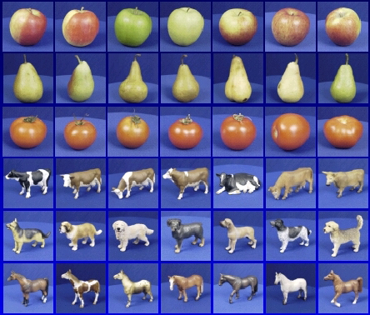

Generalization
Training set (labels known)
Test set (labels unknown)
How well does a learned model generalize from the data it was trained on to a new test set?
Slide credit: L. Lazebnik

Slide 5
Generalization
Components of generalization error
Bias: how much the average model over all training sets differ from the true model?
Error due to inaccurate assumptions/simplifications made by the model
Variance: how much models estimated from different training sets differ from each other
Underfitting: model is too “simple” to represent all the relevant class characteristics
High bias and low variance
High training error and high test error
Overfitting: model is too “complex” and fits irrelevant characteristics (noise) in the data
Low bias and high variance
Low training error and high test error
Slide credit: L. Lazebnik

Slide 6
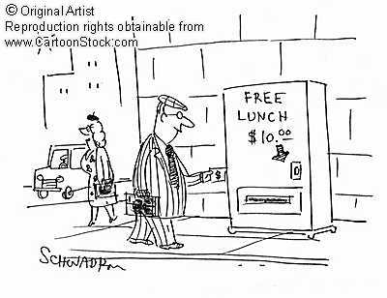
No Free Lunch Theorem
Slide credit: D. Hoiem
Notes:
You can only get generalization through assumptions.

Slide 7
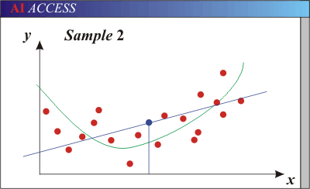
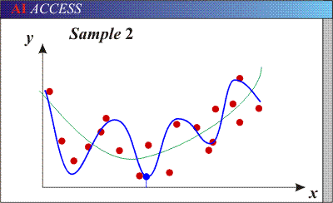
Bias-Variance Trade-off
Models with too few parameters are inaccurate because of a large bias (not enough flexibility).
Models with too many parameters are inaccurate because of a large variance (too much sensitivity to the sample).
Slide credit: D. Hoiem
Notes:
http://www.aiaccess.net/English/Glossaries/GlosMod/e_gm_bias_variance.htm

Slide 8
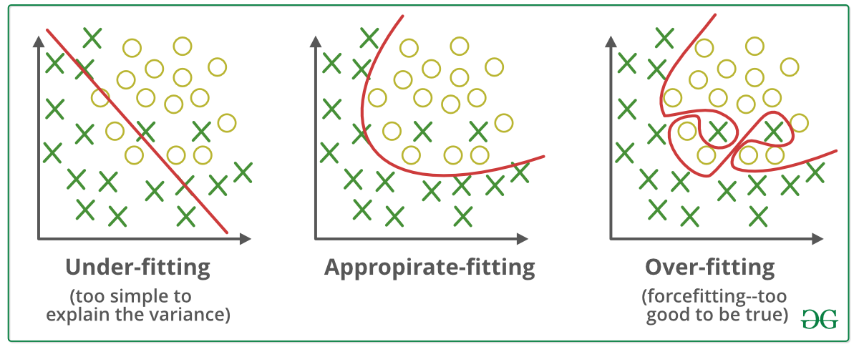
Bias-Variance Trade-off
E(MSE) = noise² + bias² + variance
Error due to variance of training samples
Unavoidable error
Error due to incorrect assumptions
See the following for explanations of bias-variance (also Bishop’s “Neural Networks” book):
http://www.inf.ed.ac.uk/teaching/courses/mlsc/Notes/Lecture4/BiasVariance.pdf
Image credit: geeksforgeeks.com
Slide credit: D. Hoiem
Notes:
From the link above:
You can only get generalization through assumptions.
Thus in order to minimize the MSE, we need to minimize both
the bias and the variance. However, this is not trivial to do this. For instance, just
neglecting the input data and predicting the output somehow (e.g., just a constant), would definitely minimize the variance of our predictions: they would be
always the same, thus the variance would be zero—but the bias of our estimate
(i.e., the amount we are off the real function) would be tremendously large. On
the other hand, the neural network could perfectly interpolate the training data,
i.e., it predict y=t for every data point. This will make the bias term vanish entirely, since the E(y)=f (insert this above into the squared bias term to verify this),
but the variance term will become equal to the variance of the noise, which may
be significant (see also Bishop Chapter 9 and the Geman et al. Paper). In general,
finding an optimal bias-variance tradeoff is hard, but acceptable solutions can be
found, e.g., by means of cross validation or regularization.

Slide 9
Bias-variance tradeoff
Underfitting
Overfitting
Error
Test error
Training error
High Bias
Low Variance
Complexity
Low Bias
High Variance
Slide credit: D. Hoiem

Slide 10
Bias-variance tradeoff
Few training examples
Test Error
Many training examples
High Bias
Low Variance
Complexity
Low Bias
High Variance
Slide credit: D. Hoiem
Notes:
Note: these figures don’t work in pdf

Slide 11
Effect of Training Size
Fixed prediction model
Error
Testing
Generalization Error
Training
Number of Training Examples
Slide credit: D. Hoiem

Slide 12
The perfect classification algorithm
Objective function: encodes the right loss for the problem
Parameterization: makes assumptions that fit the problem
Regularization: right level of regularization for amount of training data
Training algorithm: can find parameters that maximize objective on training set
Inference algorithm: can solve for objective function in evaluation
Slide credit: D. Hoiem

Slide 13
Remember…
No classifier is inherently better than any other: you need to make assumptions to generalize
Three kinds of error
Inherent: unavoidable
Bias: due to over-simplifications
Variance: due to inability to perfectly estimate parameters from limited data
Slide credit: D. Hoiem
Notes:
You can only get generalization through assumptions.

Slide 14
How to reduce variance?
Choose a simpler classifier
Cross-validate the parameters
Get more training data
Slide credit: D. Hoiem
Notes:
The simpler classifier or regularization could increase bias and lead to more error.

Slide 15


Cross-Validation
No peeking while building the model
Training Set (assuming bin. class. problem)
Test Set
Note: Not just h.p. selection; we can also use CV to pick the best ML model from a set of different ML models (e.g., say we have to pick between two models we may have trained - LwP and nearest neighbors. Can use CV to choose the better one.
Class 1
Class 2
Actual Training Set
Randomly Split
Validation Set
Randomly split the original training data into actual training set and validation set. Using the actual training set, train several times, each time using a different value of the hyperparam. Pick the hyperparam value that gives best accuracy on the validation set
What if the random split is unlucky (i.e., validation data is not like test data)?
If you fear an unlucky split, try multiple splits. Pick the hyperparam value that gives the best average CV accuracy across all such splits. If you are using N splits, this is called N–fold cross validation

